Slide 1



Temporal data with tsibble and fable
Oskar Krafft
Justus v. Samson-Himmelstjerna
Notes:
Welcome to our short workshop.
My name is Justus v. Samson and together with Oskar Krafft we will now introduce you to temporal data and how to handle those using the two R packages tsibble and fable

Slide 2


Outlook
tsibble: tidy data analysis workflow for time series data
tidy data frames combined with temporal data
fable: forecasting for time series datain a table format
Provide forecasts with time distributions, not intervals.
Specify
Tidy
Visualise
Estimate
Forecast
Evaluate
Notes:
In order to do so we are going to introduce you to a workflow in R wich builds on the tidyverse by utilising two packages.
First tidying, wrangling, and inspecting the Data will be done with the help of the tsibble package.
With the help of the fable package we will then use some forecasting models and visualise our Data

Slide 3
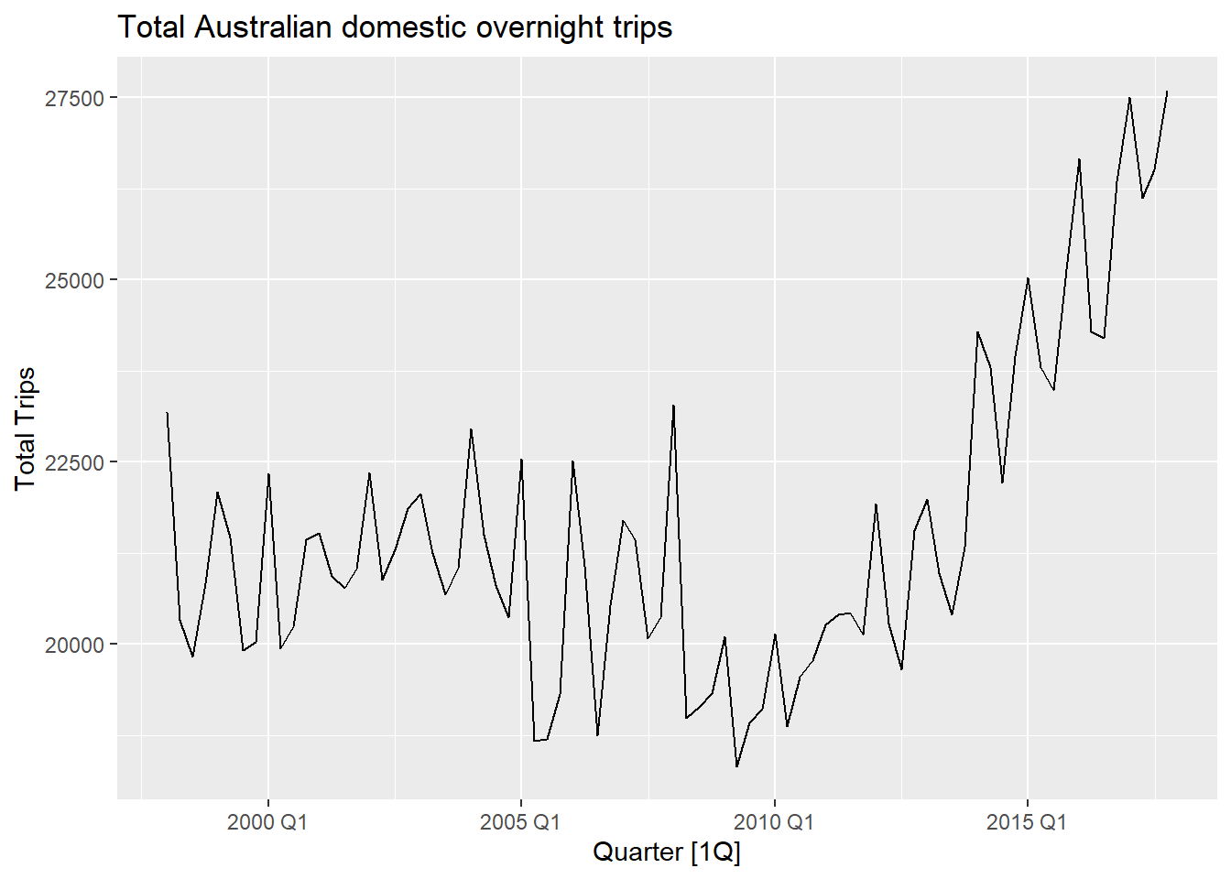
Vocabulary for time series analysis
Trends
Long-term overall increase or decrease in the Data
Does not have to be linear
Seasonal
Data affected by seasonal factors
Seasonality has fixed periods
Cyclic
Rises and falls of unknown frequency
For example economic cycles
Notes:
In General when we are looking at a graph, which is plotting temporal data like the one on the right, we can describe the time series by analysing trends, seasonality and cycles
Trends describe long-term overall increase or decrease in the Data, which do not have to be linear.
For example we can see a clear upwards trend from 2010 onwards
Seasonal effects are reoccurring increases or decreases within fixed and known time periods, such as Holidays or climatic seasons.
In the dataset on the right we can assume that the spikes occur in correlation to holidays within Australia and therefore are seasonal effects.
Cyclic effects are similar effects to seasonality however they are not bound to known frequencies or periods. Examples here would include economic crisis or business cycles.
All over all time series can be thought of as a series of data points,wich are indexed along some information about at what times those measurements were recorded.
We will now learn how to store this information within R as a tsibble and what we can do with those.

Slide 4
Grammar of tsibble
Index is a variable with inherent ordering from past to present.
Key is a set of variables that define observational units over time.
Each observation should be uniquely identified by index and key.
Interval computed from index, ranging from year to nanosecond, from numerics to ordered factors.
Intervals can be Regular as well as Irregular
Interval | Class
Annual | integer/double
Quarterly | yearquarter
Monthly | yearmonth
Weekly | yearweek
Daily | Date/difftime
Subdaily | POSIXt/difftime/hms
Notes:
The tsibble package provides a data class in order to represent temporal data in a Tidy Tibble format.
A tsibble consists of a time index, key consisting of a set of variables that define the observational units, and other measured variables.
Within tsibble the Index and Key are used to uniquely identify each observation, keeping with the idea of the general tidy workflow.
The Key can be a single or multiple variables and can be created in conjunction with tidy selectors like the starts_with() function.
Furthermore Tsibble supports Regular as well as arbitrary index classes. However it must pe possible to ordered both Regular the same as Irregular indices from the past to the future.
Those intervals can range from nanoseconds up to years. We have listed a few commonly used Intervals and there Grammar on right hand side of this slide.
In comparison to general tibbles the column which is specifying the observation’s measurement time is now actually used with in the data.

Slide 5
Common verbs used in tsibble
as_tsibble() → Coerce Data to a tsibble object
count_gaps() → Count implicit gaps
fill_gaps() → Turn implicit missing values into explicit missing values
has_gaps() → Show if a tsibble has implicit gaps
filter_index() → filtering time index for a tsibble
index_by() → Group by time index and collapse with summarise()
group_by_key(). → Group by key variables
Notes:
Here, we now see some commonly used functions from the tsibble package.
First up with as_tsibble we can create a tsibble object by coercing the data.
The next three help us wrangle data wich has some gaps in them. That would be the case for example if one time series starts a a later point then the other. In This case we can first count the implicit gaps with the help of the count_gaps function and then utilising fill_gaps we can decide if we want to treat implicit gaps as NA/s, set them to 0 or for example equal to the mean. With has_gaps we could also simply check if a tsibble has implicit gaps at all.
Next up we can filter the time index with filter_index as well as group by the time index with index_by
Otherwise we could also group by key.

Slide 6
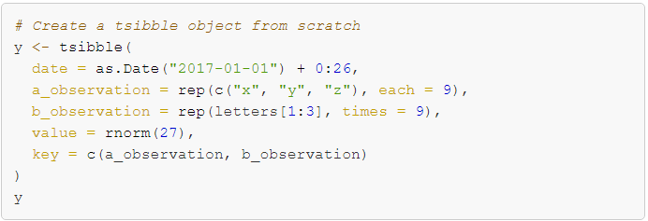
Data preparation and manipulation (tsibble)
Notes:
Having now gotten to know the functionalities of tsibble we can create our first object with multiple variables for key
In this case we have an interval of 26 regularly spaced dates giving us the index to plot against.
And the key consisting of the two vectors a_observation and b_observation.
By setting the value = rnorm(27), rnorm generates random deviates with a length of 27 results.

Slide 7
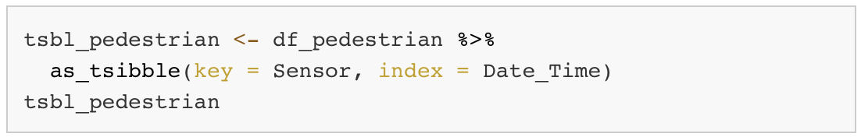
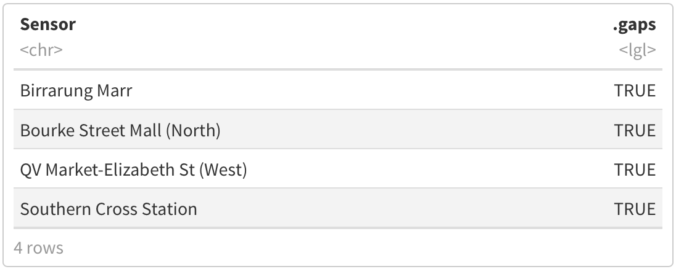
Data preparation and manipulation (tsibble)
Notes:
On this slide we are taking a dataset which contains hourly counts of pedestrians from 4 sensors around Melbourne.
Using the as_tsibble function we are coercing the data into a tsibble object and setting the key equal to the Sensor column and are indexing those against the time that the count was taken by using the Date_Time class.
After doing so we can see that all four sensors are having gaps in their data by using the has_gaps function.
By setting the Argument .full equal to True we are inserting Nas in each gap, over the entire time span of the data, If we would have chosen False than this would only have happen within every period and gaps before or after would stay untouched.

Slide 8
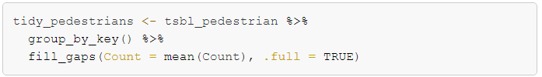
Data preparation and manipulation (tsibble)
Notes:
Another method to handle implicit gaps in our temporal data would be the fill_gaps function.
Here we can specify what we want to fill the gaps with. In our case we are computing the mean and inserting it once again in each gap, over the entire time span of the data since we still are setting the .full argument equal to True.

Slide 9

A forecasting workflow for time series data
Data preparation and manipulation
Model specification and estimation
Forecasting and choosing the best Model
Notes:
Thank you Justus! Now, we will lead you through a forecasting workflow with Fable.
Fable was built as a successor of the “forecast” package and builds on the tsibble data structure.

Slide 10
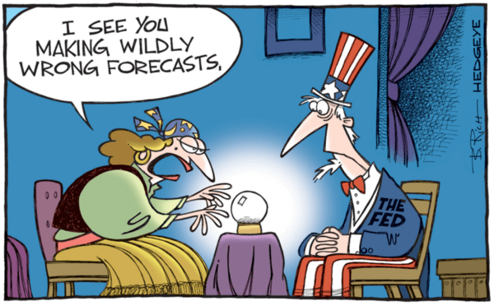
What even is Forecasting?
Image Source (last access: 16.11.2022
Notes:
Before Jumping into fable, we should clarify what we mean by forecasting in data science!

Slide 11
What even is Forecasting?
"Forecasting is about predicting the future as accurately as possible, given all of the information available, including historical data and knowledge of any future events that might impact the forecasts.“
The predictability of an event or a quantity depends on several factors including:
how well we understand the factors that contribute to it;
how much data is available;
how similar the future is to the past;
whether the forecasts can affect the thing we are trying to forecast.
Source: Hyndman, R.J., & Athanasopoulos, G. (2021)
Notes:
Forecasting is about predicting as accurately as possible given all information available that might impact the future.
What differentiates bad forecasts from good ones?
Here you can see four criteria.
The predictability of an event or a quantity depends on several factors including:
how well we understand the factors that contribute to it;
how much data is available;
how similar the future is to the past;
whether the forecasts can affect the thing we are trying to forecast.
Over the last year, there was a lot of discussion around the inflation forecasts of central banks. However, forecasts from central banks affect market expectations. Thus, we should not place too much faith in the face value of their forecasts.
With that out of the way, lets look at the package fable and where it fits into the worklow

Slide 12
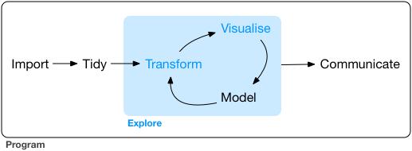
Fable in the Tidy Workflow
Specify
Tidy
Visualise
Estimate
Forecast
Evaluate
Notes:
So where does fable shine? Fable’s main application is in the model part of the workflow.
The main specified goal of the package is to integrate nicely into the tidyverse and this shows in the model syntax of fable.

Slide 13
The tidy model syntax of fable
R> Transform(y) ~ {model specification}
Left Hand Side - Response | Right Hand Side - Specials
Defines the response variable from the Data | Model specific special functions
Specification of transformations (which are automatically back-transformed) | Several models at the same time possible
Notes:
The model syntax is compatible with formula syntax in the tidyverse.
However, we will not spend much time on specifying the models we will use as this would require theoretical knowledge that is beyond the scope of this workshop.
For everyone who wants to dive deeper into forecast modelling, you can find additional resources at the end of the presentation.

Slide 14
Common fable verbs and models
Model() → Model specification using models such as:
ETS() → Exponential smoothing
ARIMA() → Autoregressive integrated moving average model
TSLM() → Linear model with time series components
forecast() → Forecast Data using the specified model
glance() → Construct a single row summary of the model
Evaluation metrics e.g. accuracy() → Summarise the performance of the model using accuracy measures
Notes:
Let’s briefly talk about some of the most important verbs and models used within fable!
After we have prepared and transformed the data into a tidy tsibble that contains useful information for our analysis, we specify our models through listing them inside the Model() function.
Two of the most popular models to produce forecasts are exponential smoothing and ARIMA. The basic idea behind expontential smoothing as proposed in the late 1950s is the computation of weighted averages of past observations. The weights decay exponentially as the observations get older. In other words, the more recent the observation, the more weight it has for the prediction.
This framework generates reliable forecasts quickly and for a wide range of time series, which is a great advantage and of major importance to applications in the industry.
ARIMA models provide another approach to time series forecasting and represent a complementary approach to exponential smoothing. While exponential smoothing models are based on a description of the trend and seasonality in the data, ARIMA models aim to describe the autocorrelations in the data.
Lastly, the basic idea behind the time series linear regression model is the assumption of a linear relationship of one time series with another..
Another crucial verb in the fable package is the forecast function which, as the name already gives away, forecasts data using the specified models.
Lastly, we can use glance to inspect our models and use model evaluation metrics such as the accuracy function to evaluate the performance of our models.

Slide 15
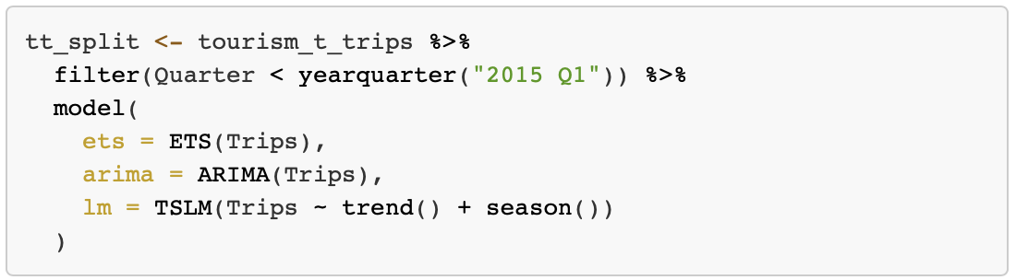
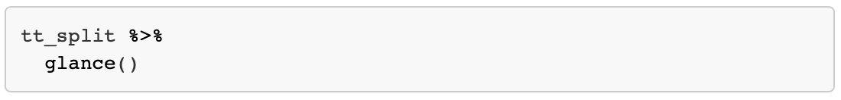
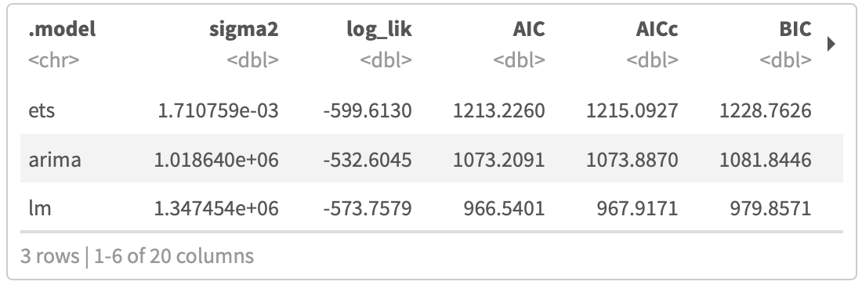
Model specification and forcasting (fable)
Notes:
Now, lets finally move to the code and apply fable.
In this code, we are using a tsibble object that contains data on the total number of quarterly domestic overnight trips in Australia.
Of course, we have already inspected and explored our data, and used the tsibble functionality to fill implicit gaps when needed.
What you can see in the first code chunk is a pipe that effectively removes the last 3 years from the data that our three models are being trained on.
The model function shows the specification of a default exponential smoothing model, a default arima model, and a linear model that includes a linear time trend () and a dummy seasonality ()
Afterwards, we inspect our models by using glance.

Slide 16
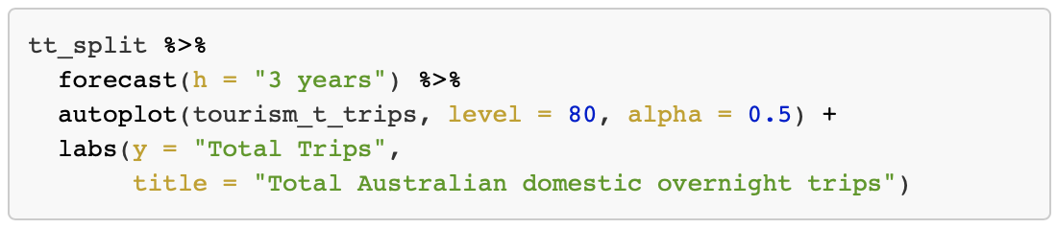
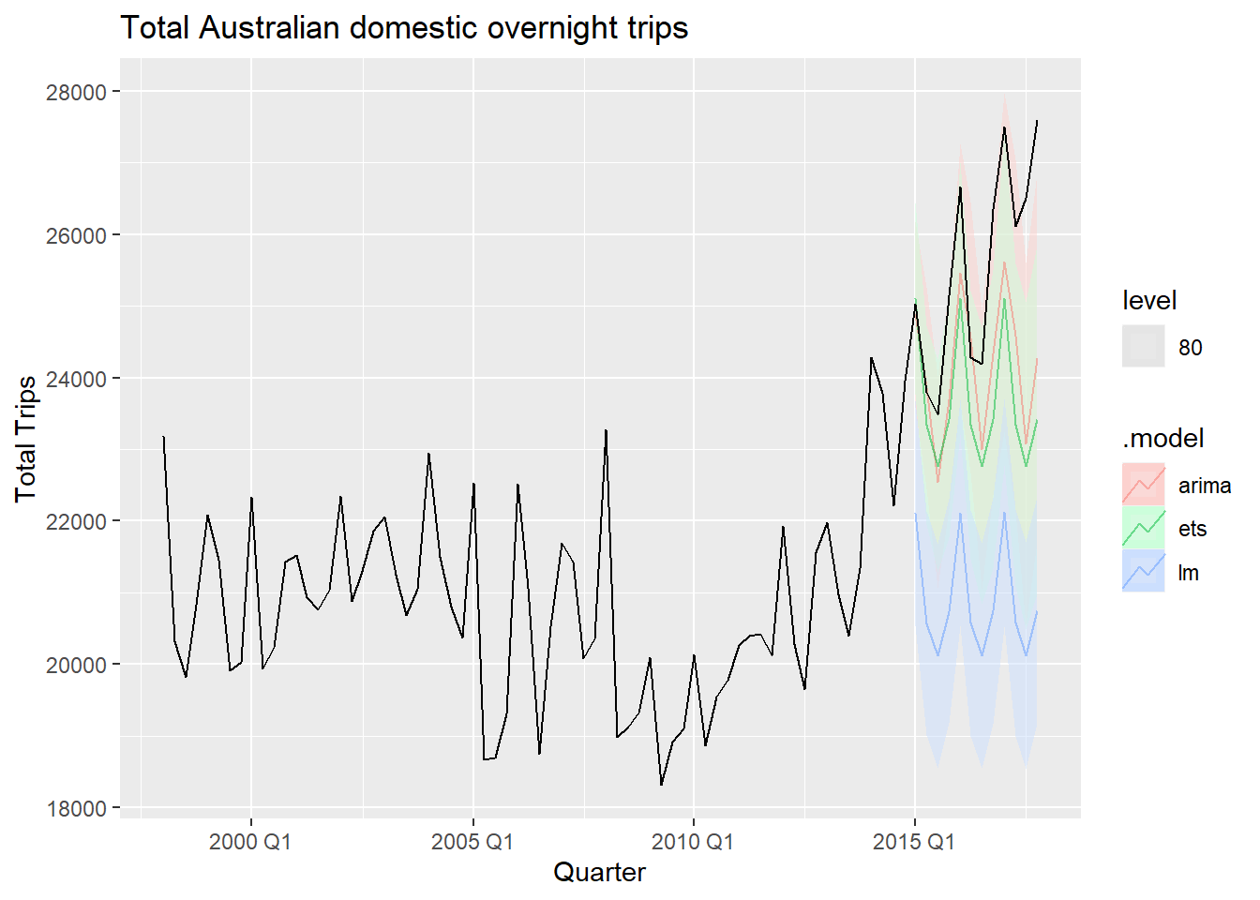
Producing forecasts
Notes:
.
Now we are ready to create forecasts using our trained models.
The forecast function in the code chunk takes the trained models and asks them to forecast the total trips for the next three years (which represents the original time range).
We then use the autoplot function to create plot that shows the three forecasts.
As we can see:
The linear model seems to have produced the worst forecasts
All models captured the seasonality of the data well, however, the arima model was able to capture the positive trend in the data the best.
Thus, the arima model, according to this plot seems to have produced the best forecast.

Slide 17
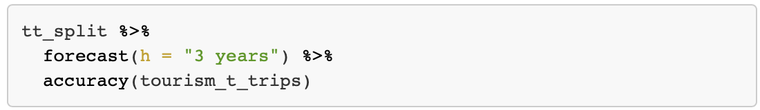
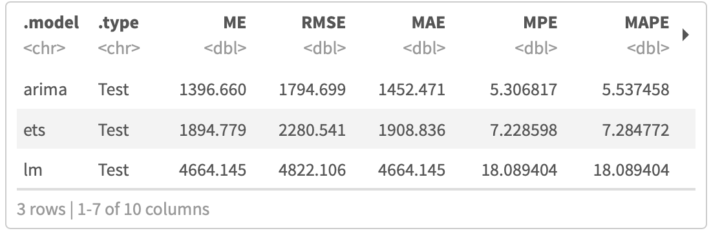
Producing forecasts
Notes:
.
Of course, can also compare the model performance based on more than just looking at plots.
For example, we can compare them based on the accuracy metric as shown by the code chunk.
Furthermore, can try to tweak our model specification to create even better forecasts.
All of this, however, is beyond our scope here today.

Slide 18
What have we learned today?
Time series can be described by Trends, Seasonality, and Cycles.
The tsibble package provides a data class to represent tidy temporal data.
A tsibble consists of a time index, key, and other measured variables in a data-centric format.
Further packages are building upon tsibble to further analyse and visualise temporal data.
Fable helps forecasting for time series data in a table format.
Keeping with the tidyverse models in fable define the response variable on the left hand side and model specific functions on the right hand side.
Fable can be used to produce forecasts and asses how well different models perform.
Notes:
So what have we learned?

Slide 19
Further Reading
Tidyverse Webpage for tsibble: https://tsibble.tidyverts.org
Tidyverse Webpage for fable: https://fable.tidyverts.org
Cran Webpage by the tsibble creator:
http://cran.nexr.com/web/packages/tsibble/vignettes/intro-tsibble.html
Cran package description for tsibble:
https://cran.r-project.org/web/packages/tsibble/tsibble.pdf
Cran package description for fable:
https://cran.r-project.org/web/packages/fable/fable.pdf
Introduction to fable by package creator:
https://www.mitchelloharawild.com/blog/fable/
Book by Rob J Hyndman on forecasting principles:
https://otexts.com/fpp3/

Slide 20
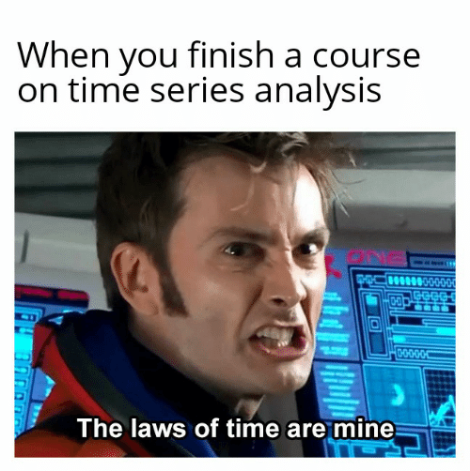
Notes:
Thanks for paying attention and we hope you have fun completing the exercises!

